Slide 1
Assignment 6 Guideline
CSE205 @ ASU.
Winston Smith & Cheng-Yu

Slide 2
Introduction
Please use Zoom office hours or discussion forum right away when you get stuck.
This walkthrough will assume you already have JavaFX installed and running.
If you haven’t installed JavaFX, then please refer to the tutorial on Canvas.
This assignment is large just like Assignment 5, so please get started early!
TAs may not be able to help everyone in the last few days before this assignment is due.

Slide 3
Before Getting Started:
Software Design

Slide 4
Software Design Process for a Program
Assignment 6 is not difficult at all but may be “complicated”
Think about the following questions:
What/how should the GUI look like?
What are GUI elements (Java classes) that I should use?
What is the relationship (hierarchy) of the GUI elements?
How will the user use the GUI application? How does this interaction trigger a series of “events”?
Warning: If you find yourself do not have clear answers to all of these questions, you may want to close your IDE right now, grab a paper and pen, and read the following slides carefully.

Slide 5
Requirements, Please
After reading the instructions carefully, you should be able to extract the requirements of your customer.
The design in three terms:
Data model (what to store)
GUI template (how it looks like)
Controller (how the user, model. template work with each other)
At least we have the following requirements:
A GUI program that stores a series of data about departments, including title, number of faculty, and name of university
It allows the user to “Add a Department”
It lists the stored department data
It allows the user to “Select” some departments and compute the total number of faculty in the selected departments.

Slide 6
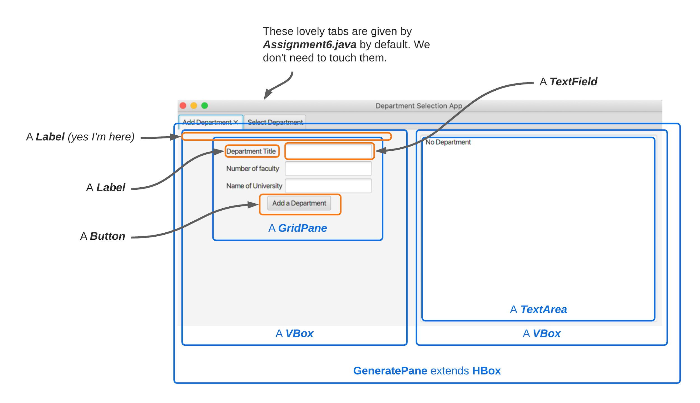
Template: What do we want to see on the window? (GeneratePane.java)

Slide 7
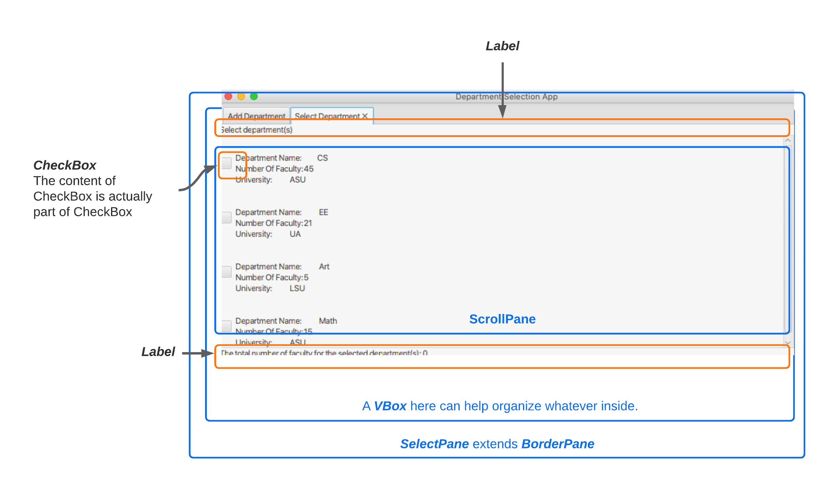
Template: What do we want to see on the window? (SelectPane.java)

Slide 8
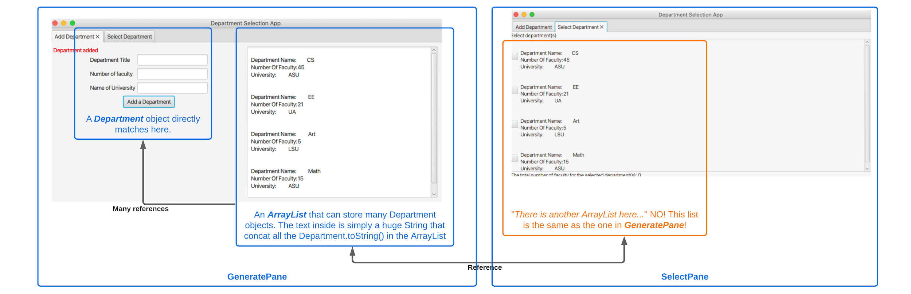
Data Model: Which part of the program store/need the data?
Do you realize there is only one data object (of the ArrayList type) in this whole program?

Slide 9
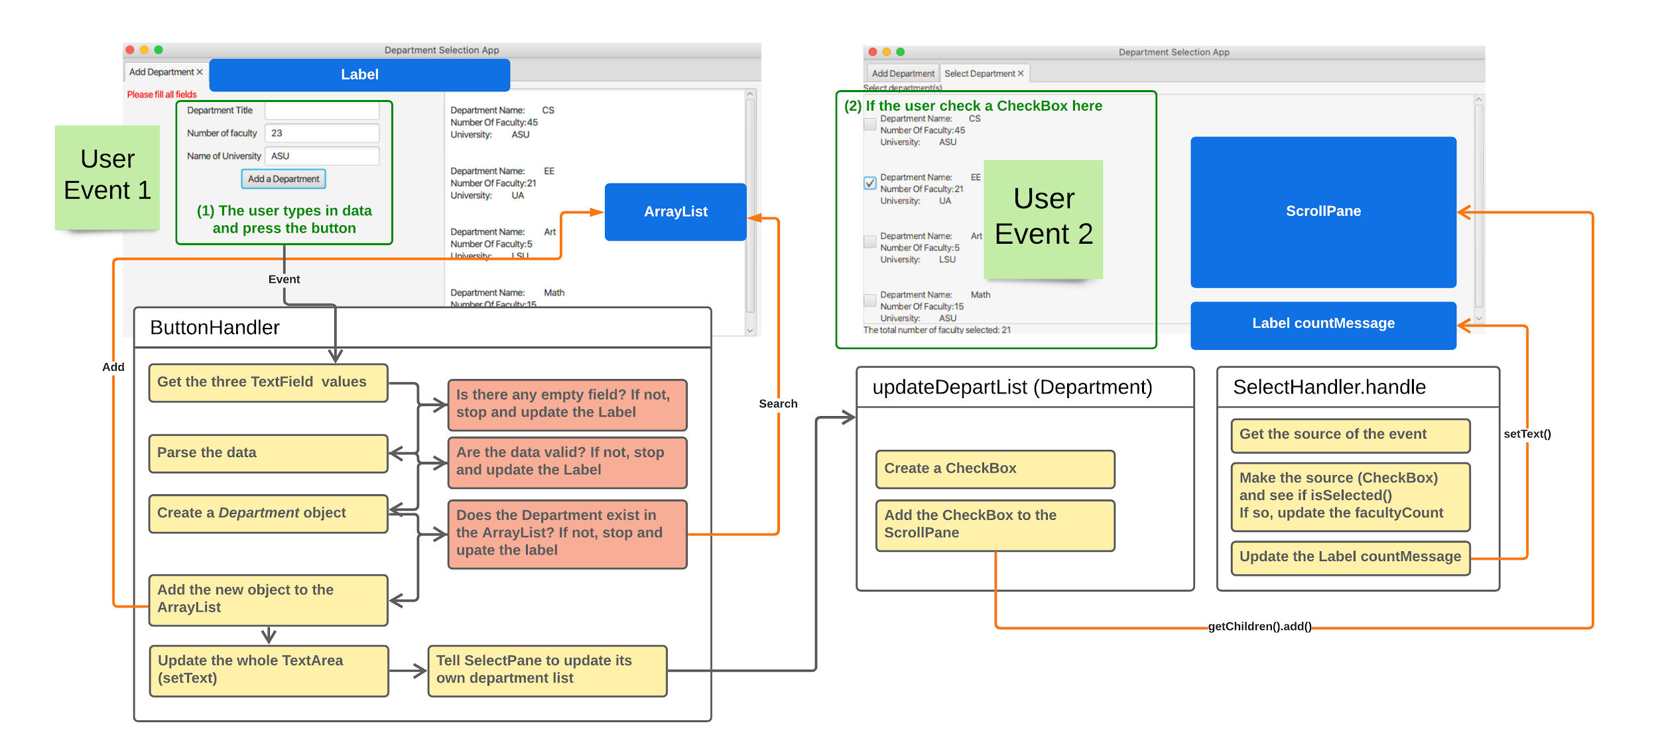
Controller: How the program interacts with the user, how the elements interact with each others?
For the readability, some interactions are omitted.

Slide 10
Prototype: Follow your design and lay some code out in the Java files
For GUI templates, keep comments about the hierarchy and order. For example, in GeneratePane.java,
Initialize 3 + 1 Labels, and 3 TextFields
Initialize 1 Button
Initialize 1 TextArea
Initialize 1 GridPane, 2 VBox
Afterward, think about how to add things to the right places. That is to ask:” which element should contain which elements?”

Slide 11
Something to Note

Slide 12
What files are provided?
Assignment6.java
This is the major top-level controller that organizes everything.
You don’t need to make any changes. But you should read through and see how it works.
Pay attention to how it organize SelectPane and GeneratePaner
Department.java
This is the core data model.
You don’t need to make any changes here. But, again, please read through it and think about its relationship with the other elements (See Slide 8: Data Model: Which part of the program store/need the data?).

Slide 13
What files are provided?
GeneratePane.java (Slide 6: Template: What do we want to see on the window? (GeneratePane.java))
Create the GUI for “Add Departments”
Allow the user to add a new Department object
Allow the user view the stored Department objects.
SelectPane.java (Slide 7: Template: What do we want to see on the window? (SelectPane.java))
Create the GUI for “Select Department(s)”
Allow the user to view the stored Department objects
Allow the user to select to compute the total number of faculty.

Slide 14
Something to Note
We do not worry about the style of your GUI.
For example, don’t worry about 1” or 2” of spacing
It may be easier if you start with GeneratePane.java

Slide 15
Basic UI Elements

Slide 16
How to make a Button
Buttons need a label and a position in order to work properly. Thankfully, these are both easy to set. For the label, you can use this code:
Button button = new Button(“My Label);
This will create a Button that is labeled as “My Label”.

Slide 17
How to make a TextField
TextFields allow the user to type text into them. You can make a TextField the same way you make a Button, except that you don’t need a label. So, the code looks like this:
TextField myTextField = new TextField();
One note that will be important for later: You can use the getText() and setText(String newValue) methods to get and set the text of a TextField.

Slide 18
How to create a Label
Labels combine the simplest parts of both Buttons and TextFields. They aren’t editable by the user, and the user can’t click them. Their constructor is similar to a Button:
Label myLabel = new Label(“My Label”);
The text of a Label can be changed via the setText(String newText)
You can also use the setTextFill(...) method to set text color:
myTextField.setTextFill(Color.RED);

Slide 19
How to create a TextArea
A TextArea can be instantiated in the same way as other elements:
TextArea myTextArea = new TextArea();
In the same way as a TextField, you can getText() and setText(String newText) with a TextArea.
setText(...) is mostly useful here to set your initial value for the TextArea and to update the text as we add departments.
You may also want to do myTextArea.setEditable(false) to prevent the user from changing it.
Then, we will need to add both our GridPane and our TextArea (as well as the Button and the error Label, if you put those in separate Panes) to our GeneratePane.

Slide 20
Tips for GeneratePane.java

Slide 22
Adding Panes to GeneratePane.java
The code to add an element to our GeneratePane is very simple:
this.getChildren().addAll(element1, element2, element3, …);
You may need to play with the setMargin(...), setSpacing(...), setAlignment(...), and/or setHgrow(...) methods to get your formatting approximately correct.
You may also want to create instance variables for your UI elements, but this is not required. You can call this.getChildren() to get the list of child UI elements.

Slide 23
How to use the GridPane (1/2)
A GridPane is a handy way to organize your UI. It allows you to place UI elements in a grid, and handles most of the formatting for you. A GridPane is can be thought of as a 2D array of UI elements.
We will first need to instantiate our GridPane:
GridPane gridPane = new GridPane();
Then, you will need to add elements to it:
gridPane.add(button1, 0, 0, 1, 1);
The arguments are (the Node To Add, Column Index, Row Index, Column Span, Row Span)

Slide 24
How to use the GridPane (2/2)
You can add padding or Hgap and Vgap to your GridPane; feel free to play with these.
You can also add the Button to your GridPane or create a separate Pane for the Button.

Slide 25
About the ButtonHandler
We need to set up an EventHandler for when our user clicks the Button, and then actually program what should happen when that Event happens.
To set up the EventHandler, you can do this:
buttonName.setOnAction(new ButtonHandler());
We can do this because we have a nested ButtonHandler class.

Slide 26
About the ButtonHandler
Whenever the user clicks the Button, your handle(...) method will be called.
This method should handle input checking (via getText()and setText(...)as mentioned before) as well as adding a new Department to both departList and the TextArea.
You will first need to call getText() from each of the TextFields to read what the user entered
Then, you can follow the comments in the given file for a step-by-step walkthrough on how to process the data.

Slide 27
Tips for SelectPane.java

Slide 29
How to use the BorderPane
The overall problem for the SelectPane is a classic use-case of a BorderPane.
You have some information you want to display across the top, some information in the middle, and some information on the bottom.
You can set top, middle, and bottom information with the
setTop(Node element)
setCenter(Node element)
setBottom(Node element)
Because SelectPane extends BorderPane, you can directly call this.setTop(...) to add a Node to the SelectPane

Slide 30
How to use the ScrollPane
A ScrollPane allows the user to scroll through some content (the scroll bar(s) only appear if needed). It is useful when the content can be very small or very large, which is exactly what we have here.
To put content into a ScrollPane, we have to use the setContent(...) method. You can call this method like this:
myScrollPane.setContent(oneElement);
Because the ScrollPane can contain one element but we have many CheckBoxs, you can make a VBox to include all CheckBoxs, and add the VBox to the ScrollPane.

Slide 31
How to create a CheckBox and plug in the label?
To make a CheckBox with a label:
CheckBox myCheckBox = new CheckBox(newdep.toString());
When the user clicks a CheckBox, we want something to happen. You need SelectHandler here.
We can add the event handler to our CheckBox the same way we did for Buttons:
myCheckBox.setOnAction( new SelectionHandler(newdep.getNumberOfMembers()));
Once you have a new CheckBox, make sure you add it to the checkboxContainer

Slide 32
Set up the SelectHandler
Again, our CheckBox needs a handler to react if the user clicks it.
We can do this by calling getSource() with a cast to CheckBox:
(CheckBox)event.getSource().isSelected()
This will tell us whether or not the CheckBox that the user just clicked is currently selected or unselected.
If it is selected, we need to add members to the number of faculty currently selected. If it is unselected, we need to subtract. Keep in mind you have the field variable facultyCount.

Slide 33
Conclusions

Slide 34
Conclusions
Please use Zoom office hours and/or the discussion forum when you get stuck, and need help
Please go to TA’s Office Hours, the earlier you go, the easier it is to get into the room.
Make sure to test your code before turning it in!
This tutorial is very helpful for anything you didn’t understand:
https://docs.oracle.com/javafx/2/get_started/jfxpub-get_started.htm
Make sure to get an early start; this is by far the hardest assignment you’ve had yet!

